Slide 1


Communication Breakdown: Understanding and Overcoming
Effective Strategies for Improved Workplace Communication

Slide 2
Understanding Communication Breakdown
Definition of Communication Breakdown
Types of Communication Breakdown
Common Causes of Communication Breakdown
Impact of Communication Breakdown
Barriers to Effective Communication
Strategies for Improving Verbal Communication
Overcoming Communication Barriers
Role of Emotional Intelligence
Creating a Communication-Friendly Environment

Slide 3
Definition of Communication Breakdown
The failure or disruption in the process of exchanging information between individuals or groups
leads to misunderstandings, confusion, or ineffective communication
Occurs when there is a breakdown in the transmission, reception, or understanding of messages
resulting in a gap between the intended message and the message received.

Slide 4
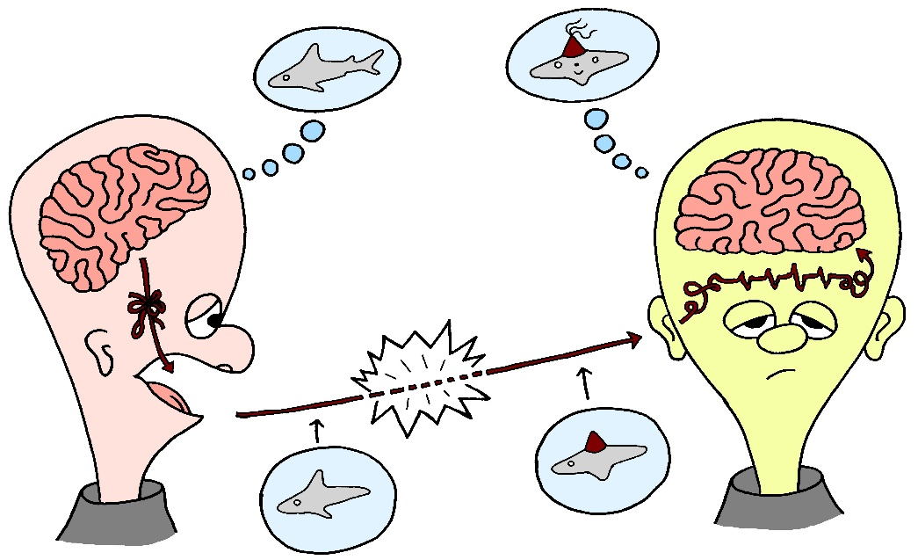
Types of Communication Breakdown
Verbal Misunderstandings
Non-verbal Misinterpretations
Written Communication Errors
This Photo by Unknown Author is licensed under CC BY

Slide 5
Verbal Misunderstandings
Verbal communication breakdown occurs when there is a misunderstanding in spoken language.
This can happen due to unclear or ambiguous language,
misinterpretation of tone or intent,
differences in dialects or accents,
or simply not listening attentively.
Verbal misunderstandings can lead to confusion, conflict, and miscommunication.

Slide 6
Non-verbal Misinterpretations
Nonverbal communication breakdown occurs when there is a discrepancy between verbal and nonverbal cues.
Nonverbal communication includes body language, facial expressions, gestures, and tone of voice.
Misinterpreting nonverbal cues can result in misunderstandings about emotions, attitudes, or intentions, leading to communication breakdown.

Slide 7
Written Communication Breakdown
Written communication breakdown occurs when there are mistakes or misinterpretations in written messages.
This can include spelling errors, grammatical mistakes, unclear or vague language, lack of context, or misaligned expectations.
Poorly written communication can lead to confusion, misinterpretation, and ineffective exchange of information.

Slide 8
Common Causes of Communication Breakdown
Lack of Active Listening: When individuals are not fully engaged in listening, they may miss important information, misinterpret messages, or fail to grasp the speaker’s intended meaning.
Active listening involves focusing on the speaker, asking clarifying questions, and demonstrating understanding through verbal and nonverbal cues.
Assumptions and Stereotypes: When individuals make assumptions about others’ perspectives, intentions, or beliefs without seeking clarification, it can result in a communication breakdown.
Stereotypes based on preconceived notions or biases can also hinder effective communication by influencing perceptions and interactions.

Slide 9
Common Causes of Communication Breakdown
Information Overload: Excessive information or data can overwhelm individuals and impede effective communication.
When there is an overload of information, important messages may get lost or overlooked, leading to confusion and miscommunication.
Language Barriers: Language barriers, including differences in language proficiency, vocabulary, or communication styles, can create obstacles to effective communication.
When individuals speak different languages or have limited proficiency in a common language, misunderstandings and misinterpretations can occur, resulting in communication breakdown.

Slide 10
Impact of Communication Breakdown
Misunderstandings and Confusion: When communication breaks down, misunderstandings and confusion can arise, leading to errors, delays, and inefficiencies.
Misinterpreted messages, unclear instructions, or lack of clarity can result in individuals not understanding expectations, tasks, or goals, which can hinder progress and productivity.
Conflict and Tension: Communication breakdown can escalate into conflicts and tensions within teams or between individuals.
Miscommunication, lack of transparency, or misunderstandings can create friction, resentment, and mistrust among team members. Unresolved conflicts stemming from communication breakdown can disrupt collaboration and teamwork.
Reduced Productivity: Ineffective communication can hamper productivity and workflow efficiency.
When messages are not clearly conveyed, tasks may be delayed, duplicated, or completed incorrectly.
Communication breakdowns can lead to rework, missed deadlines, and decreased output, impacting overall productivity and organizational performance.

Slide 11
Impact of Communication Breakdown
Damaged Relationships: Poor communication can strain relationships and erode trust among colleagues, supervisors, and stakeholders.
Can damage professional relationships, hinder collaboration, and create a negative work environment.
Missed Opportunities: Communication breakdown can result in missed opportunities for innovation, growth, and success.
Valuable ideas, feedback, or insights may go unnoticed or unutilized.
Can hinder decision-making and strategic planning, limiting organizational progress.
Customer Dissatisfaction: In customer-facing roles, communication breakdown can lead to dissatisfied customers and lost business opportunities.
Poor communication with clients, customers, or external stakeholders can result in misunderstandings, unmet expectations, and negative experiences.
Customer loyalty and reputation may be compromised due to communication failures.

Slide 12
Improving verbal communication
Practice active listening by focusing on the speaker, maintaining eye contact, and showing interest in the conversation.
Ask clarifying questions to seek additional information or confirm your understanding of the message
Avoid interrupting and instead, wait for the speaker to finish before responding.
Articulate your words clearly and avoid using jargon or complex language that may confuse the listener.
Organize your thoughts before speaking to ensure clarity and coherence.

Slide 13
Improving Non-verbal communication
Body Language Awareness: Pay attention to your body language, including posture, gestures, facial expressions, and eye contact. Maintain an open and confident posture, use gestures to emphasize points, display genuine facial expressions that match your message, and establish appropriate eye contact to convey attentiveness and engagement.
Regulate Your Tone of Voice: Your tone of voice conveys emotions, attitudes, and intentions. Practice modulating your tone to match the context and message you are conveying. Use variations in pitch, volume, and pace to express enthusiasm, empathy, authority, or other emotions appropriately.
Mirror and Match: Mirroring involves subtly imitating the body language of the person you are communicating with, such as mirroring their posture or gestures.
Matching involves aligning your nonverbal cues with the other person's to create a sense of harmony and understanding.

Slide 14
Improving Non-verbal communication
Use Space and Proximity: Be mindful of personal space and proximity when interacting with others. Respect cultural norms and individual preferences regarding personal space. Adjust your proximity based on the relationship and context to effectively communicate comfort, respect, and boundaries.
Monitor Your Facial Expressions: Facial expressions play a significant role in nonverbal communication. Be aware of your facial expressions to ensure they align with your verbal message and emotions. Practice displaying genuine and appropriate facial expressions to convey sincerity, empathy, and understanding.
Seek Feedback and Self-Reflection: Request feedback from trusted individuals or mentors on your nonverbal communication to gain insights into areas for improvement. Engage in self-reflection to assess your nonverbal cues, identify any inconsistencies between your verbal and nonverbal communication, and work on aligning them effectively.

Slide 15
Improving verbal communication
Clarity and Conciseness:
Organize your thoughts before writing
Avoid jargon, technical terms, or complex language that may confuse the reader.
Break down complex ideas into digestible chunks and use bullet points or lists for clarity.
Be specific and provide relevant details to support your main points without unnecessary information.
Use simple and straightforward language

Slide 16
Improving verbal communication
Proofreading and Editing:
Review your written content for spelling, grammar, punctuation, and formatting errors.
Check for consistency in style, tone, and language throughout the document.
Edit for clarity, coherence, and flow by restructuring sentences or paragraphs if needed.
Use editing tools or ask a colleague to review your work for feedback and suggestions.
Take breaks between writing and proofreading sessions to maintain focus and catch errors more effectively.

Slide 17
Improving verbal communication
Using Appropriate Tone and Language:
Consider your audience and purpose when determining the tone and language of your writing.
Tailor your tone to match the context, audience expectations, and the nature of the message.
Use a professional and respectful tone in business communication, while adjusting for a more casual tone in informal settings.
Avoid using overly formal or informal language that may not align with the intended audience.
Be mindful of cultural sensitivities, inclusivity, and diversity when choosing language and tone in written communication.

Slide 18
Stay Tuned…

